Slide 1
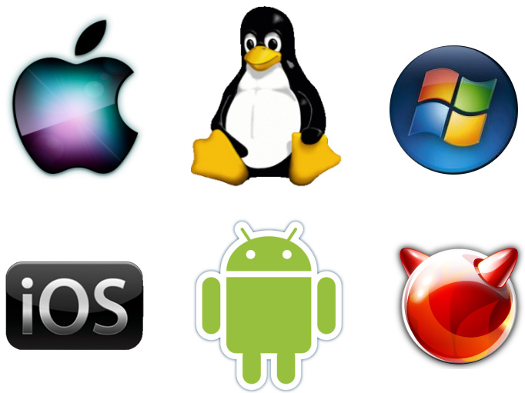
Operating System (O.S)
Lect-4

Slide 2
Operating system Method
Two basic method of services provided by O.S
System Call
System Program

Slide 3
System Call.
All O.S provide some mechanism to request service from the kernel
System call provide interface between O.S and process that allow process to invoke O.S function.it is a method by which a program request to the O.S
System Call are used to access system resources ,it transfer control from user to kernel mode
It is generally available in Assembly Language
If a user want to access system ,it first request through system call to the O.S
System call are build at the top of the O.s layer
It directly interact with kernel mode
It also interact hardware part the system like keyboard, mouse etc.
System call interface layer contain entry point in the kernel mode.
All system resources manage by kernel mode
Any request from user or application must be handle by kernel mode.

Slide 4
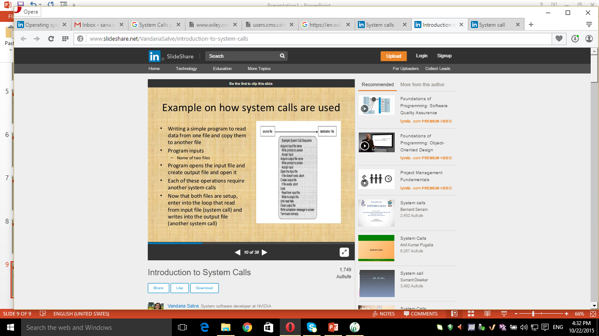
How System Call are used

Slide 5
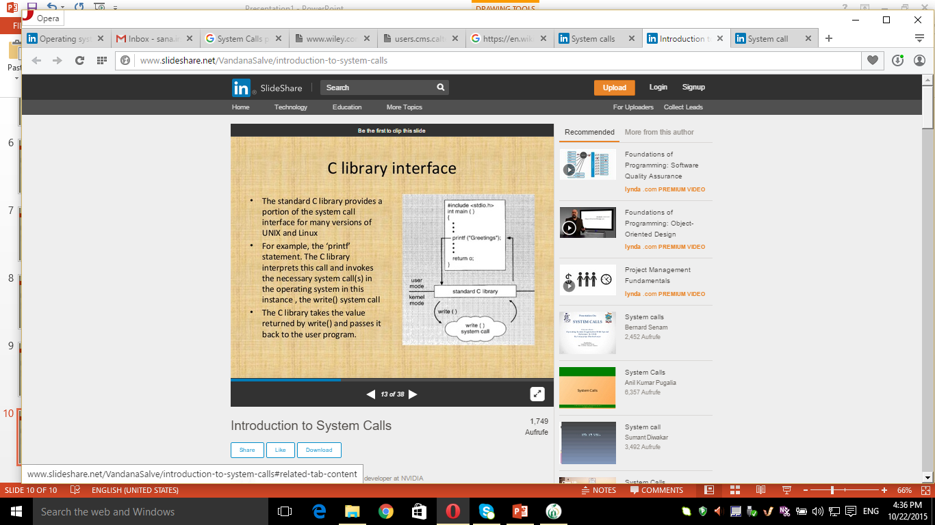
C library interface

Slide 6
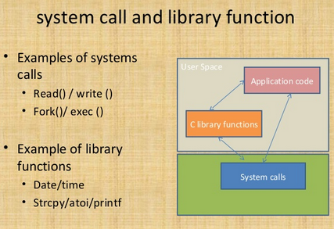
System Call and library functions

Slide 7
Types of System Call
System call are can be roughly grouped into five major categaries
Process control
File manipulation / management
Devices manipulation / management
Information handling / management
Communication

Slide 8
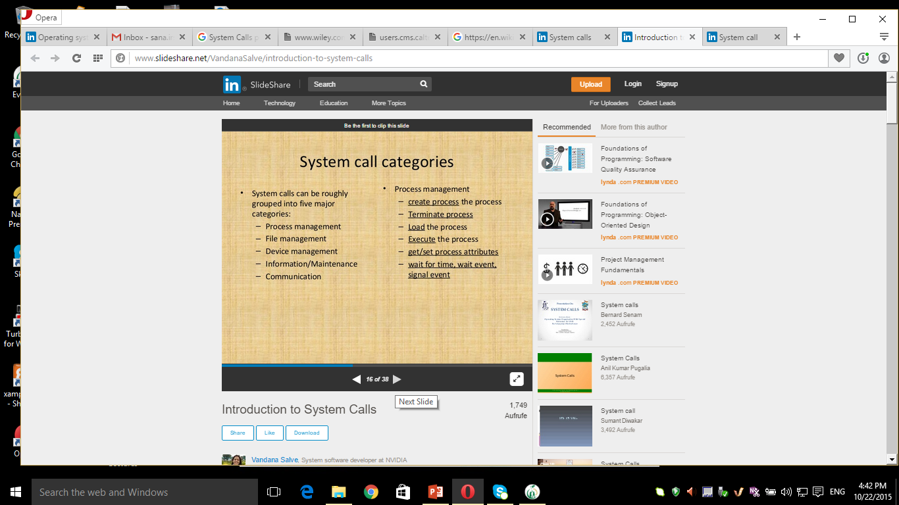
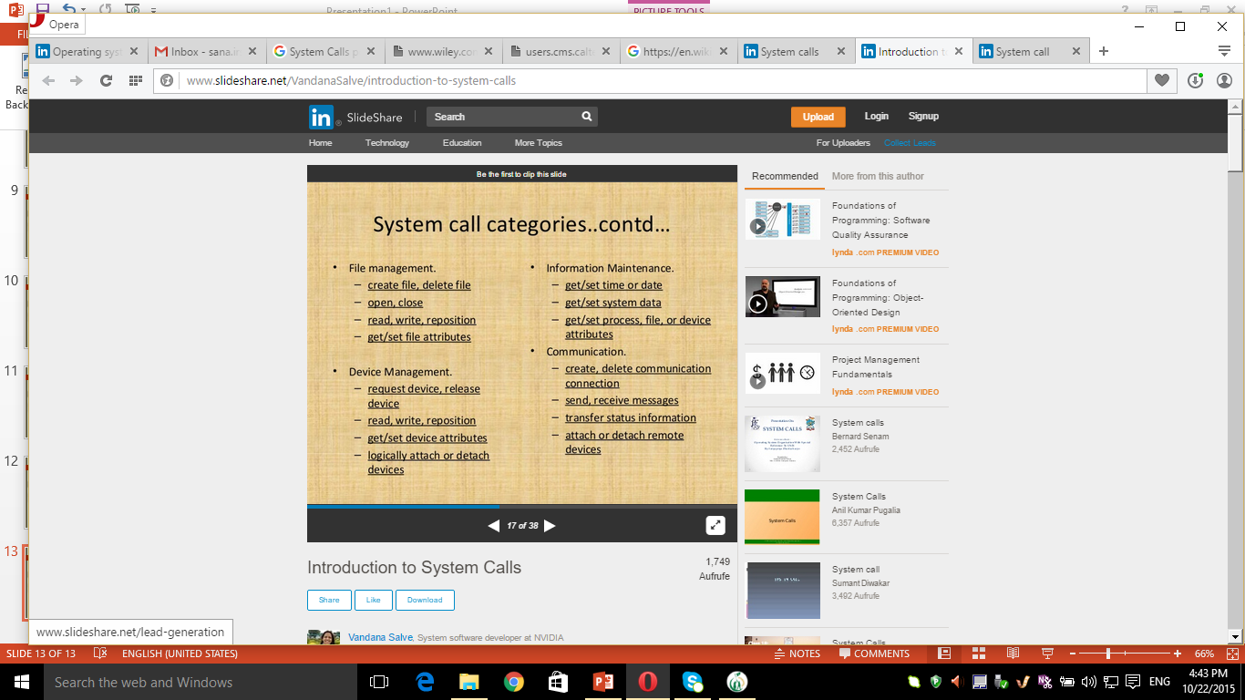

Slide 11
System Program
System program provide basic function to user so that they dont need to write their own environment for program development(compiler, editor) and program execution(shell)
In some sense they are the bundle of System call
It is also known as System Utilization

Slide 12
Types of System Program
File Management
Status Management
File Modification
Program language support
Program loading and execution

Slide 13
Types of System Program
File Management:
Some program are used to manage files example open, close, read, write etc
Status Management:
Some program specially ask for system Date, Time, No. of user amount of disk space etc.
File Modification:
Several Text Editor are available to modify the control of File.
Program language Support:
O.s provide Compiler, Assembler, interpreter for different languages(C, C++,Java,…)
Communication:
These program provide virtual connection between the process, user and computer system. They allow user to send and receive mail from one machine to another machine

